Slide 1
Creating a unit test with Qunit

Slide 2
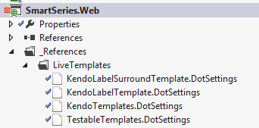

Initial Setup
Import the Resharper templates
Open the Template Explorer from Resharper Menu
Click import and find the files to the right

Slide 3
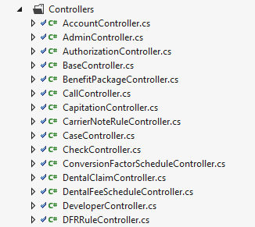
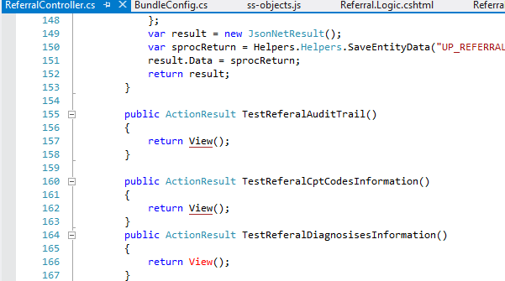
First, need to create controller method
Find the correct controller
Add a new method in the following format

Slide 4
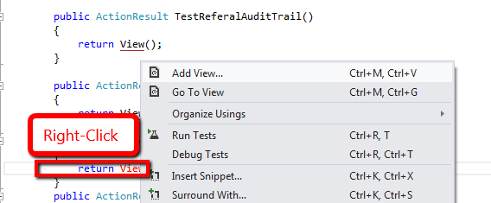
Create the View from the method
Right-click the View() select Add View..

Slide 5
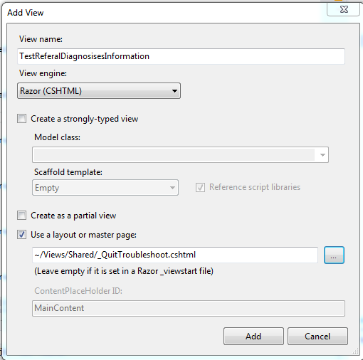
Basic View
Change to troubleshoot template

Slide 6
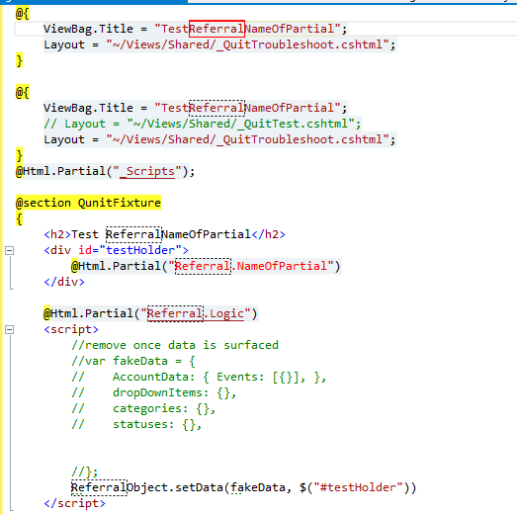
Next Steps
Highlight all and delete it
Click Control-E , Control-L to pull Resharper templates
Type “ssTest” and enter
Enter the entity name (controller) and tab
Enter the partialname and tab

Slide 7
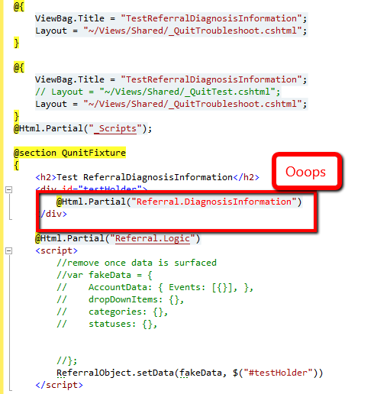
Tweak if needed

Slide 8

What it does
Sets up a content page
Includes the scripts
Calls the partial under test
Calls the logic file
Sets up the Qunit Fixture
Where the html is put
Where the fake object to pass is
Where the call to bind is
Sets up the Qunit test format

Slide 9
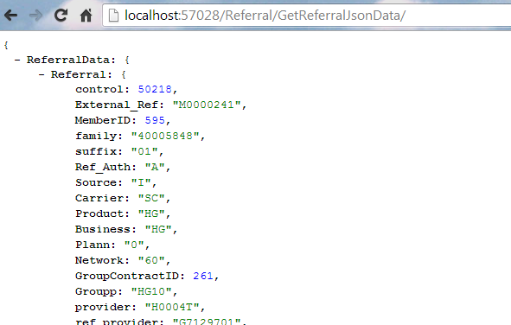
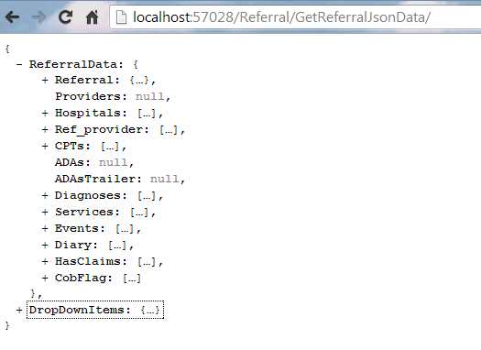
How to set the data
Use the ajax methods
JSONView Chrome Extension

Slide 10
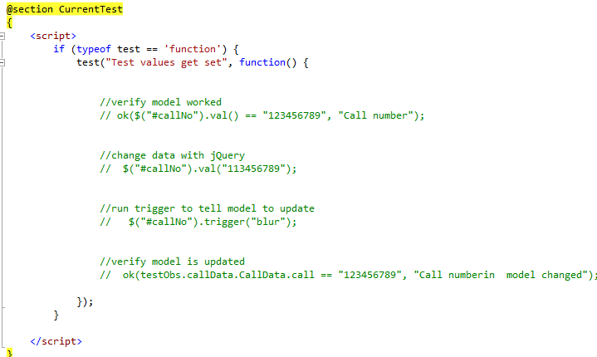
Test section
First checks if test is available
This leaves this out in troubleshoot template
Verify that the data displayed
Change the data
Jiggle the handle
Verify the change in the model

Slide 11
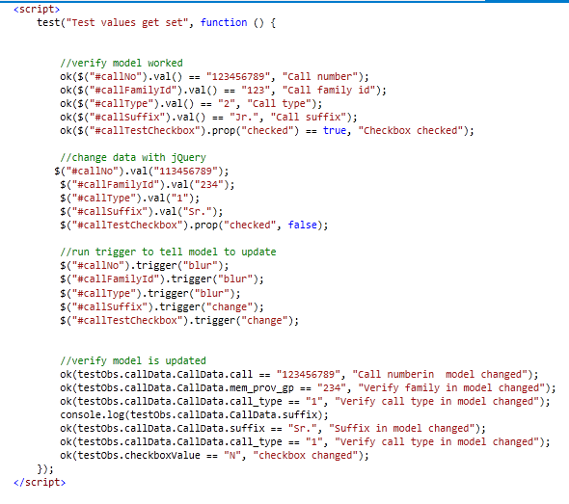
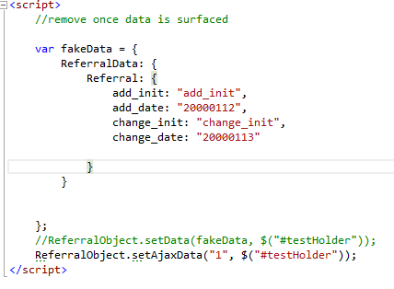
An example

Slide 12
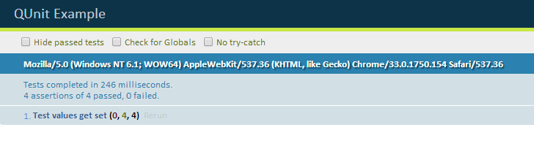
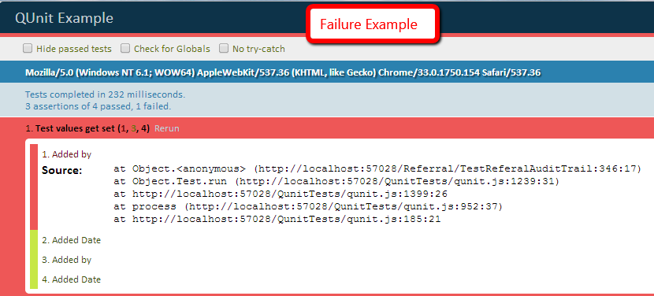
Troubleshoot with one, test with other
The Qunit test page has no interface
Hence, the other template

Slide 13
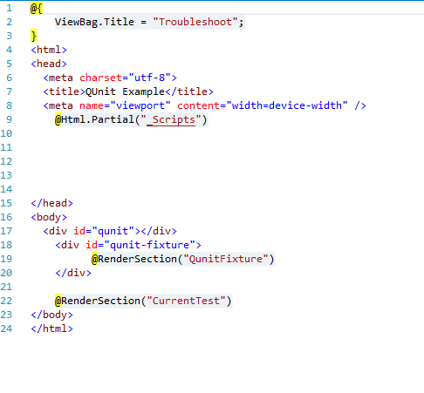
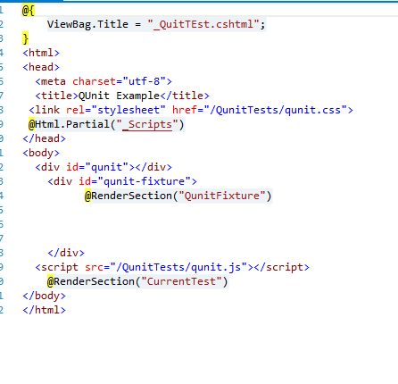
The two templates

